Slide 1
Data Preprocessing
Data preprocessing is the process of transforming raw data into an understandable format. It is also an important step in data mining as we cannot work with raw data. The quality of the data should be checked before applying machine learning or data mining algorithms.
Why is Data Preprocessing Important?
Preprocessing of data is mainly to check the data quality. The quality can be checked by the following:
Accuracy: To check whether the data entered is correct or not.
Completeness: To check whether the data is available or not recorded.
Consistency: To check whether the same data is kept in all the places that do or do not match.
Timeliness: The data should be updated correctly.
Believability: The data should be trustable.
Interpretability: The understandability of the data.

Slide 2
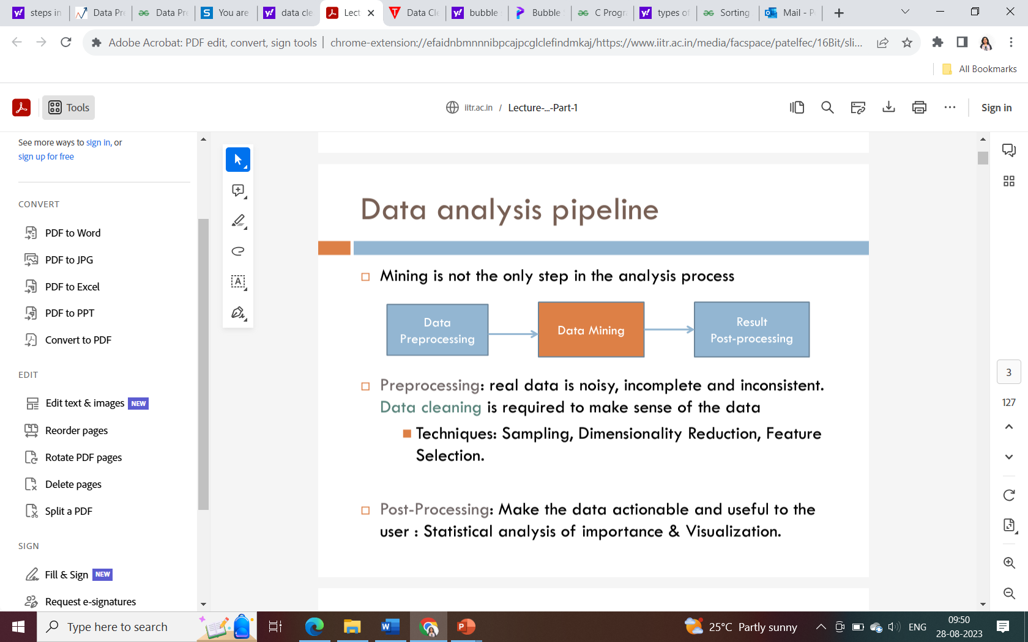

Slide 3
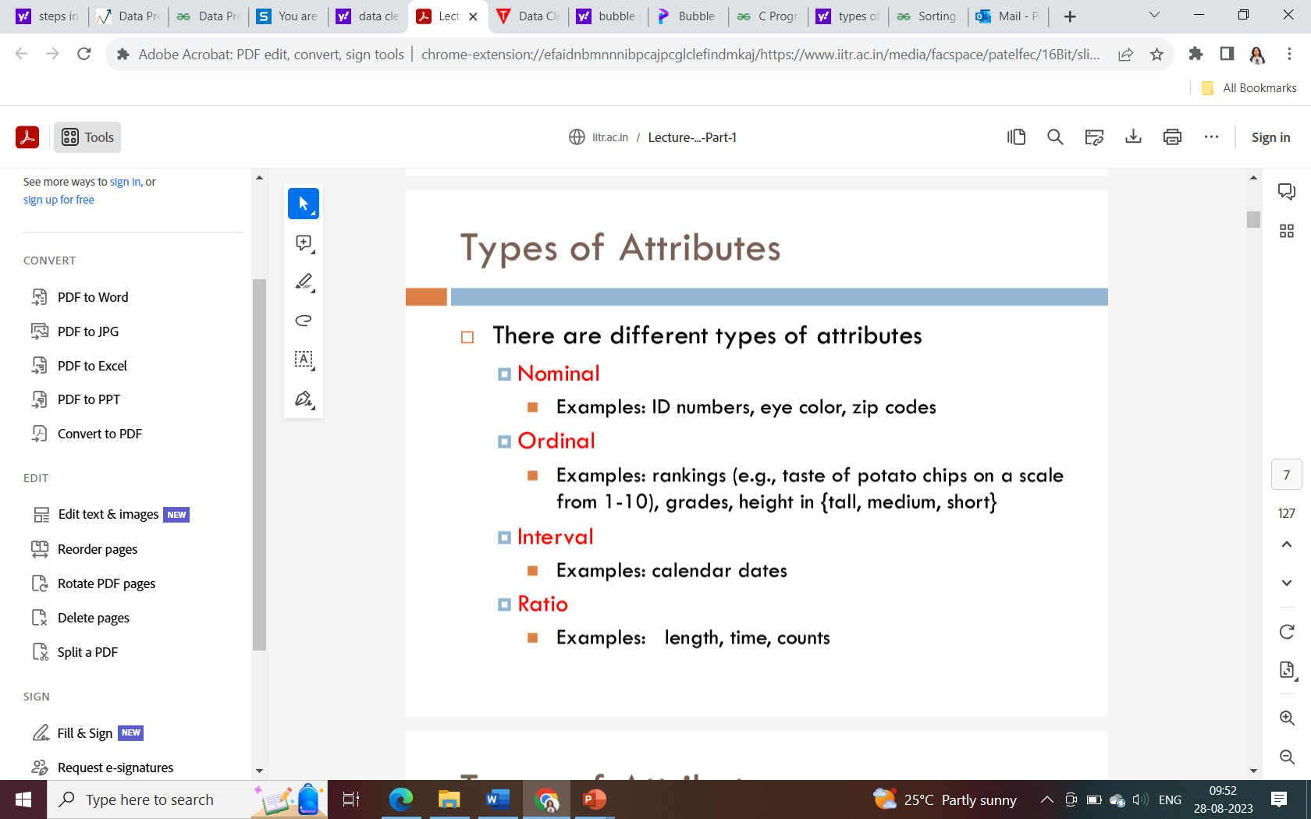

Slide 4
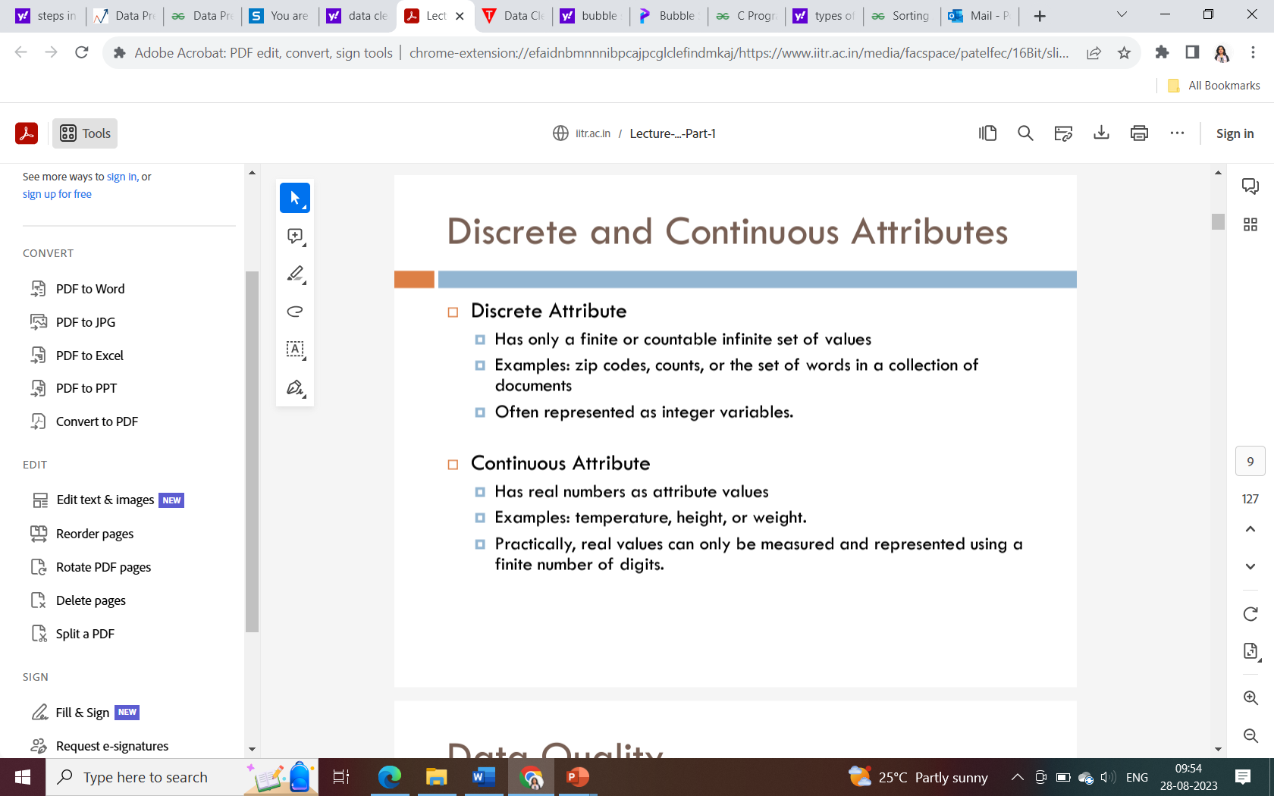

Slide 5
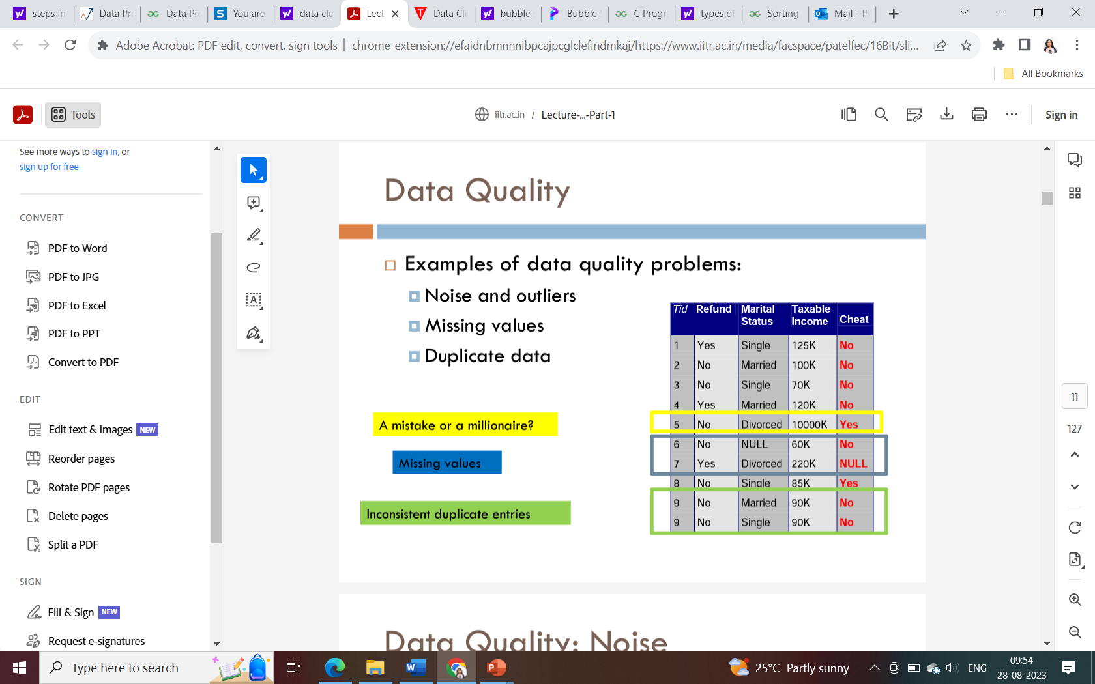

Slide 6
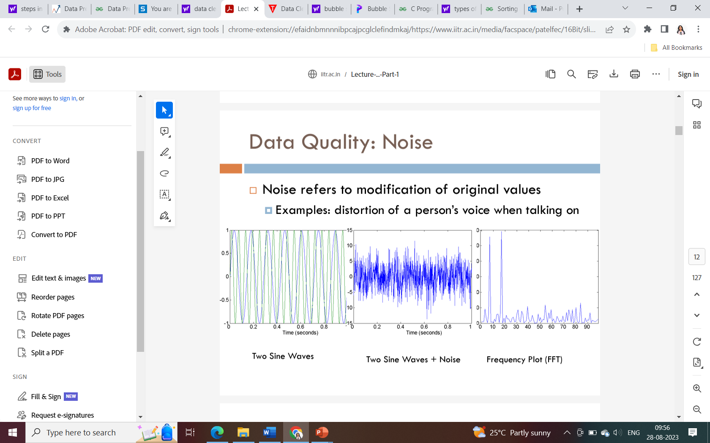

Slide 7
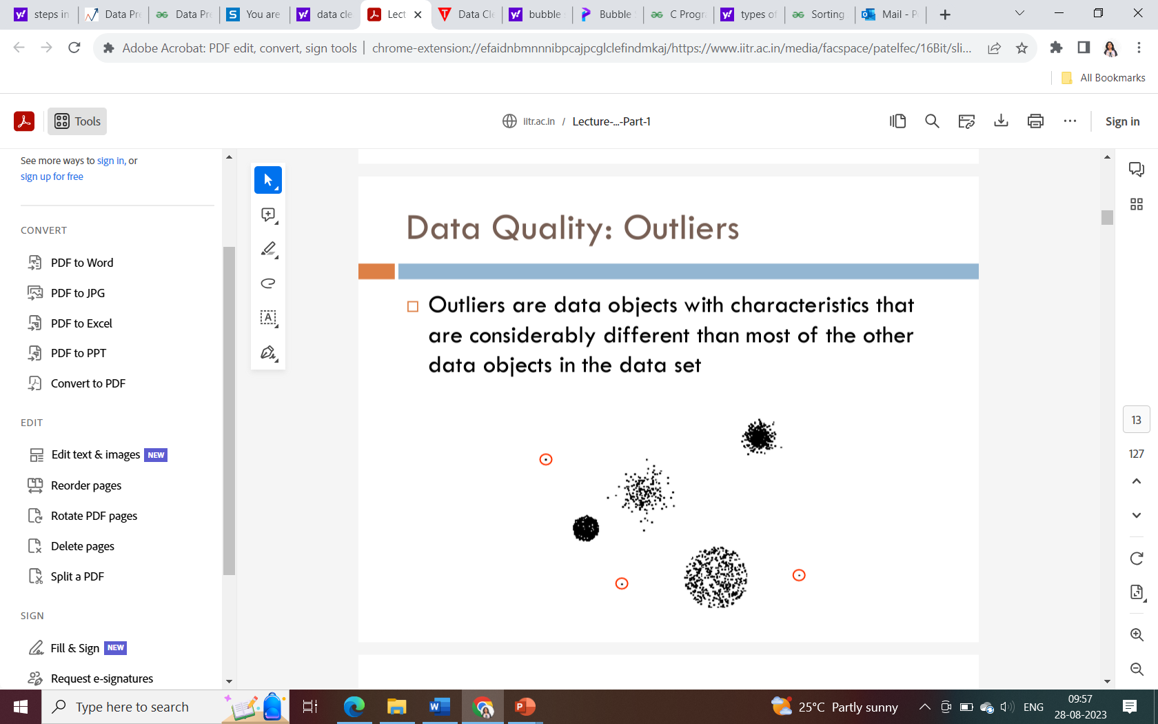

Slide 8
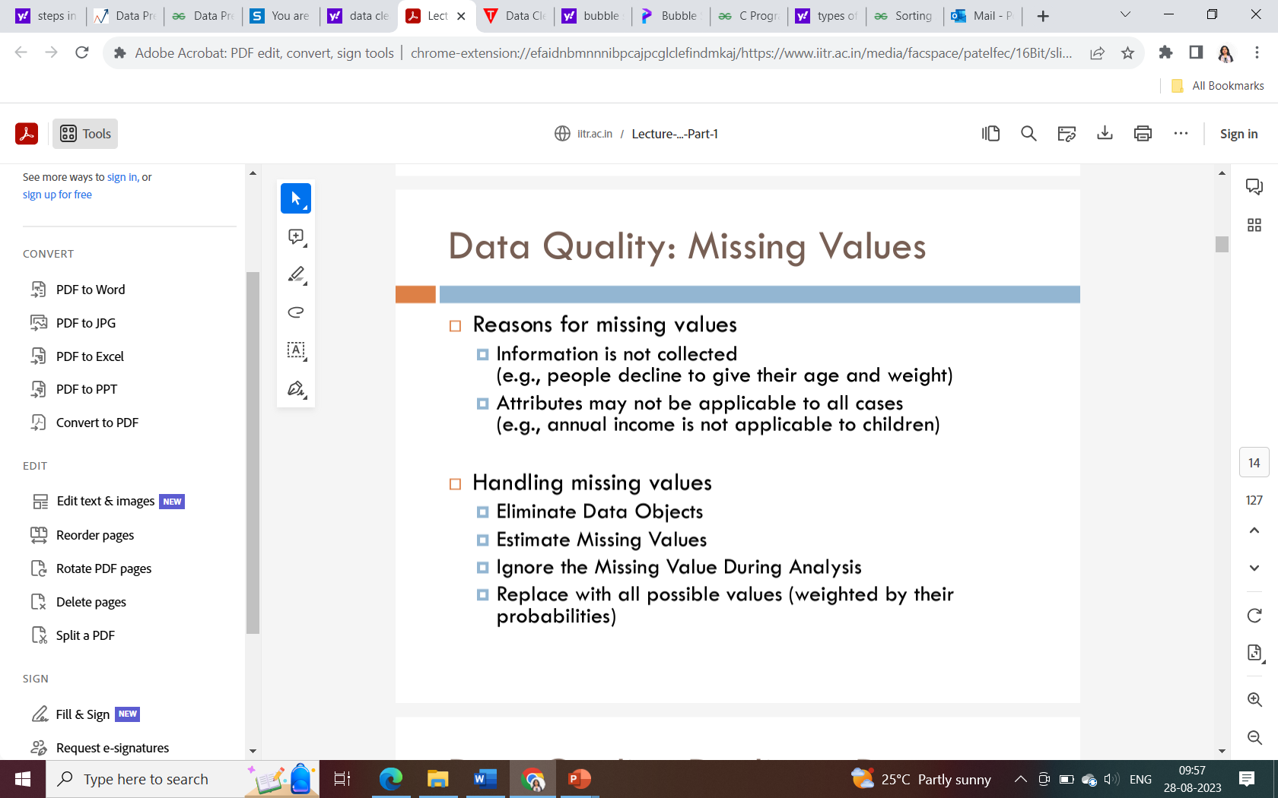

Slide 9
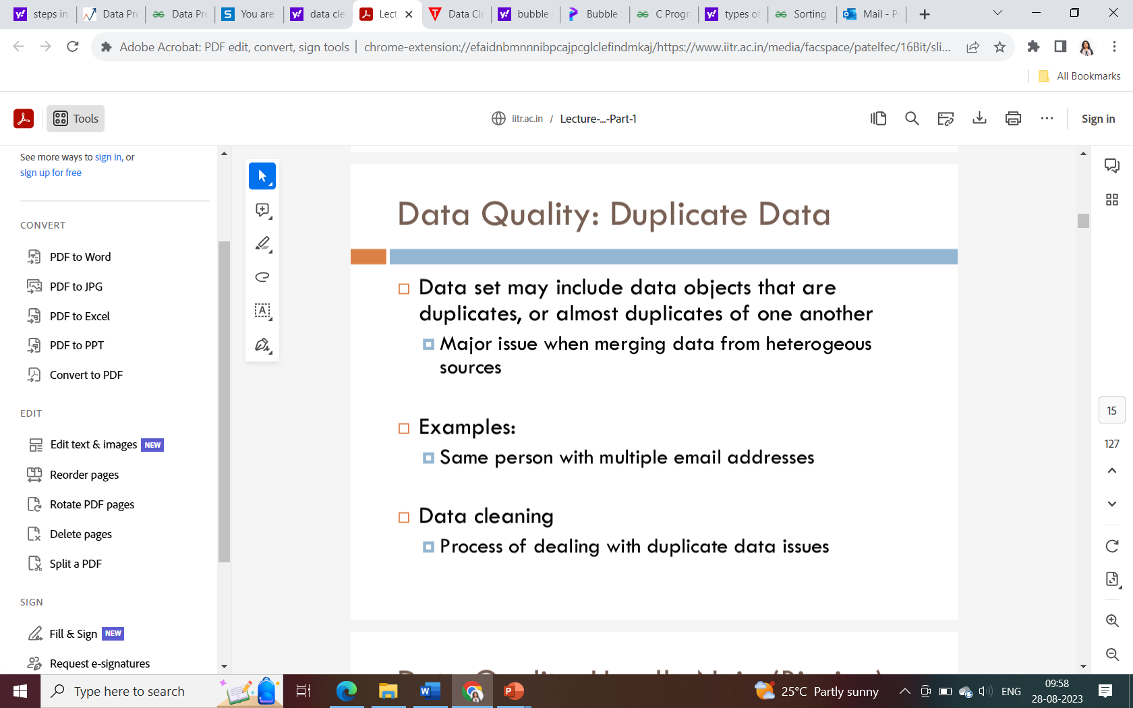

Slide 10
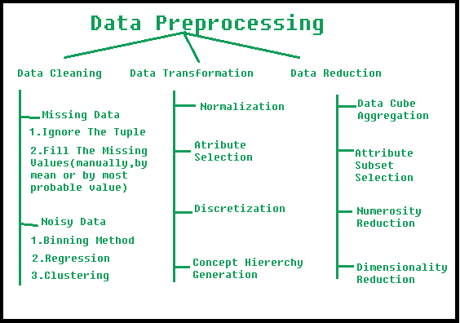
Preprocessing in Data Mining:
Data preprocessing is a data mining technique which is used to transform the raw data in a useful and efficient format.

Slide 11
Data Preprocessing Steps
Data Cleaning: This involves identifying and correcting errors or inconsistencies in the data, such as missing values, outliers, and duplicates. Various techniques can be used for data cleaning, such as imputation, removal, and transformation.
Data Integration: This involves combining data from multiple sources to create a unified dataset. Data integration can be challenging as it requires handling data with different formats, structures, and semantics. Techniques such as record linkage and data fusion can be used for data integration.
Data Transformation: This involves converting the data into a suitable format for analysis. Common techniques used in data transformation include normalization, standardization, and discretization. Normalization is used to scale the data to a common range, while standardization is used to transform the data to have zero mean and unit variance. Discretization is used to convert continuous data into discrete categories.

Slide 12
Data Reduction: This involves reducing the size of the dataset while preserving the important information. Data reduction can be achieved through techniques such as feature selection and feature extraction. Feature selection involves selecting a subset of relevant features from the dataset, while feature extraction involves transforming the data into a lower-dimensional space while preserving the important information.
Data Discretization: This involves dividing continuous data into discrete categories or intervals. Discretization is often used in data mining and machine learning algorithms that require categorical data. Discretization can be achieved through techniques such as equal width binning, equal frequency binning, and clustering.
Data Normalization: This involves scaling the data to a common range, such as between 0 and 1 or -1 and 1. Normalization is often used to handle data with different units and scales. Common normalization techniques include min-max normalization, z-score normalization, and decimal scaling.

Slide 13
Data Cleaning

Slide 14
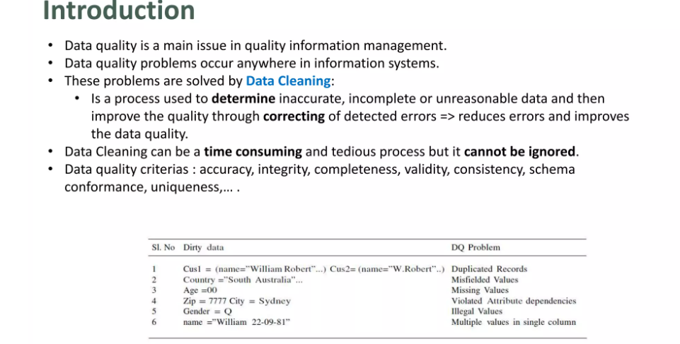

Slide 15
1. Data Cleaning:
The data can have many irrelevant and missing parts. To handle this part, data cleaning is done. It involves handling of missing data, noisy data etc.
(a). Missing Data:
This situation arises when some data is missing in the data. It can be handled in various ways. Some of them are:
Ignore the tuples:
This approach is suitable only when the dataset we have is quite large and multiple values are missing within a tuple.

Slide 16
Fill the Missing values:
There are various ways to do this task. You can choose to fill the missing values manually, by attribute mean or the most probable value.
Standard values like “Not Available” or “NA” can be used to replace the missing values.
Missing values can also be filled manually, but it is not recommended when that dataset is big.
The attribute’s mean value can be used to replace the missing value when the data is normally distributed
wherein in the case of non-normal distribution median value of the attribute can be used.
While using regression or decision tree algorithms, the missing value can be replaced by the most probable value.

Slide 17
b) Noisy Data:
Noisy data is a meaningless data that can’t be interpreted by machines. It can be generated due to faulty data collection, data entry errors etc.
Remove duplicate or irrelevant observation
Remove unwanted observations from your dataset, including duplicate observations or irrelevant observations. Duplicate observations will happen most often during data collection. When you combine data sets from multiple places, scrape data, or receive data from clients or multiple departments, there are opportunities to create duplicate data. De-duplication is one of the largest areas to be considered in this process. Irrelevant observations are when you notice observations that do not fit into the specific problem you are trying to analyze.
For example, if you want to analyze data regarding millennial customers, but your dataset includes older generations, you might remove those irrelevant observations. This can make analysis more efficient, minimize distraction from your primary target, and create a more manageable and performable dataset.

Slide 18
It can be handled in following ways :
Binning Method:
This method is to smooth or handle noisy data. First, the data is sorted then, and then the sorted values are separated and stored in the form of bins. There are three methods for smoothing data in the bin.
Smoothing by bin mean method: In this method, the values in the bin are replaced by the mean value of the bin;
Smoothing by bin median: In this method, the values in the bin are replaced by the median value;
Smoothing by bin boundary: In this method, the using minimum and maximum values of the bin values are taken, and the closest boundary value replaces the values.

Slide 19
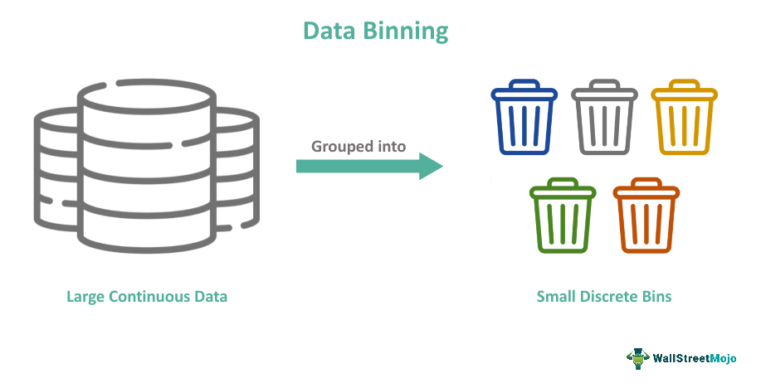
Data Binning, Bucketing, or Discretization is a data smoothing and pre-processing method to group original continuous data into small, discrete bins, intervals, or categories. Each bin is considered separate so that a general value representing the whole bin can be calculated.

Slide 20
Steps
Hence, the following general steps can be applied to perform discretization:
Identification of the dataset’s lowest and highest values to establish the range within which the data will be binned.
Choosing a suitable binning method based on the characteristics of the data in question and the objectives of conducting the analysis. Common binning methods include equal-width binning, equal-frequency binning, and custom binning.
Deciding the number of bins based on the level of granularity required, the dataset size needed, or specific analysis requirements defined for the task.
Sorting the data points into appropriate bins based on their values and defined bin boundaries. Depending on the chosen binning method, data points falling on the boundaries can be assigned to a single bin or divided between adjacent bins.
Last but not least is the analysis of data. Once the data points are assigned to bins, the data within each bin can be analyzed separately or used for visualization, such as creating histograms or bar charts.

Slide 21
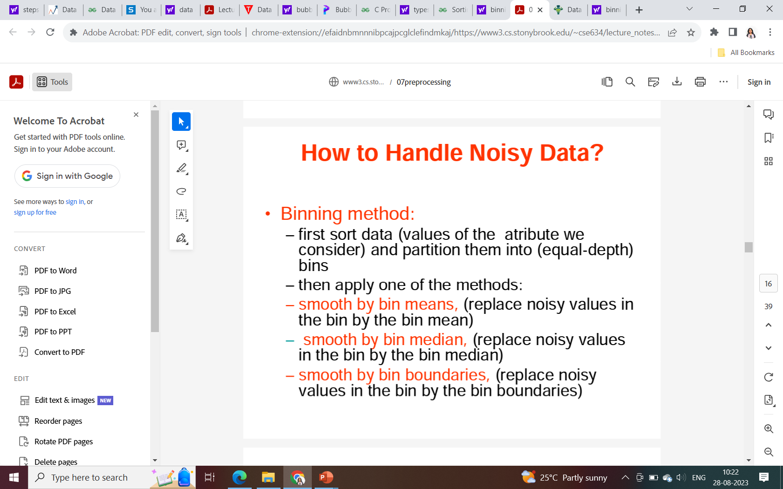

Slide 22
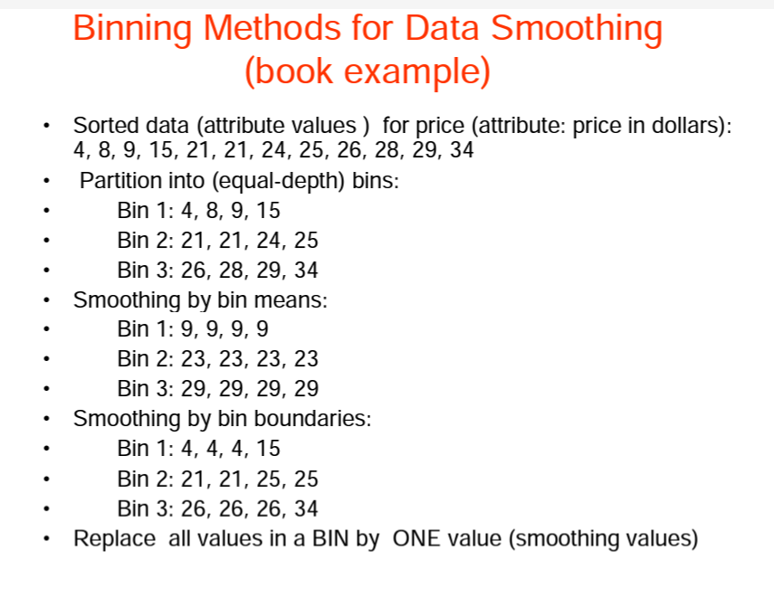

Slide 23
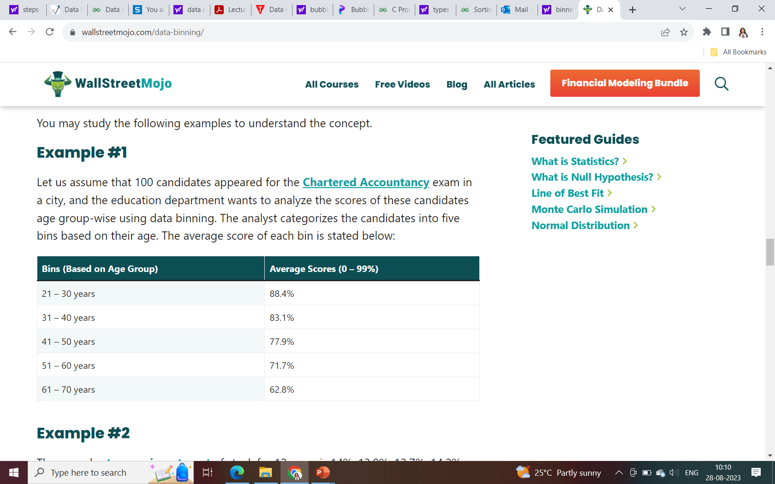
Examples
Example #1
Let us assume that 100 candidates appeared for the Chartered Accountancy exam in a city, and the education department wants to analyze the scores of these candidates age group-wise using data binning. The analyst categorizes the candidates into five bins based on their age. The average score of each bin is stated below:

Slide 24
2. Regression: This is used to smooth the data and will help to handle data when unnecessary data is present. For the analysis, purpose regression helps to decide the variable which is suitable for our analysis. Here data can be made smooth by fitting it to a regression function. The regression used may be linear (having one independent variable) or multiple (having multiple independent variables).
3. Clustering: This is used for finding the outliers and also in grouping the data. Clustering is generally used in unsupervised learning. This approach groups the similar data in a cluster. The outliers may be undetected or it will fall outside the clusters.

Slide 25
Data Integration

Slide 26
Data Integration
The process of combining multiple sources into a single dataset. The Data integration process is one of the main components of data management. Data integration in data mining refers to the process of combining data from multiple sources into a single, unified view. This can involve cleaning and transforming the data, as well as resolving any inconsistencies or conflicts that may exist between the different sources. The goal of data integration is to make the data more useful and meaningful for the purposes of analysis and decision makingThere are some problems to be considered during data integration.
Data integration can be challenging due to the variety of data formats, structures, and semantics used by different data sources. Different data sources may use different data types, naming conventions, and schemas, making it difficult to combine the data into a single view.

Slide 27
There are mainly 2 major approaches for data integration –
Tight coupling approach
Loose coupling approach
Tight Coupling:
This approach involves creating a centralized repository or data warehouse to store the integrated data. The data is extracted from various sources, transformed and loaded into a data warehouse. Data is integrated in a tightly coupled manner, meaning that the data is integrated at a high level, such as at the level of the entire dataset or schema. This approach is also known as data warehousing, and it enables data consistency and integrity, but it can be inflexible and difficult to change or update.
Here, a data warehouse is treated as an information retrieval component.
In this coupling, data is combined from different sources into a single physical location through the process of ETL – Extraction, Transformation, and Loading.

Slide 28
Loose Coupling:
This approach involves integrating data at the lowest level, such as at the level of individual data elements or records. Data is integrated in a loosely coupled manner, meaning that the data is integrated at a low level, and it allows data to be integrated without having to create a central repository or data warehouse. This approach is also known as data federation, and it enables data flexibility and easy updates, but it can be difficult to maintain consistency and integrity across multiple data sources.
Here, an interface is provided that takes the query from the user, transforms it in a way the source database can understand, and then sends the query directly to the source databases to obtain the result.
And the data only remains in the actual source databases.

Slide 29
There are three issues to consider during data integration:
Schema Integration, Redundancy Detection, and resolution of data value conflicts. These are explained in brief below.
Schema integration: Integrates metadata(a set of data that describes other data) from different sources.
Entity identification problem: Identifying entities from multiple databases. For example, the system or the user should know the student id of one database and studentname of another database belonging to the same entity.
Detecting and resolving data value concepts: The data taken from different databases while merging may differ. The attribute values from one database may differ from another database. For example, the date format may differ, like “MM/DD/YYYY” or “DD/MM/YYYY”.

Slide 30
Data Transformation

Slide 31
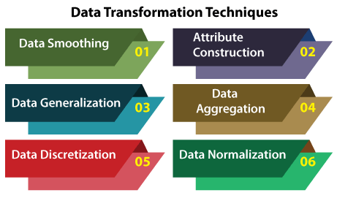
Data transformation is a technique used to convert the raw data into a suitable format that efficiently eases data mining and retrieves strategic information. Data transformation includes data cleaning techniques and a data reduction technique to convert the data into the appropriate form.
Data Transformation Techniques

Slide 32
1. Data Smoothing
Data smoothing is a process that is used to remove noise from the dataset using some algorithms. It allows for highlighting important features present in the dataset. It helps in predicting the patterns. When collecting data, it can be manipulated to eliminate or reduce any variance or any other noise form.
The noise is removed from the data using the techniques such as binning, regression, clustering.
Binning: This method splits the sorted data into the number of bins and smoothens the data values in each bin considering the neighborhood values around it.
Regression: This method identifies the relation among two dependent attributes so that if we have one attribute, it can be used to predict the other attribute.
Clustering: This method groups similar data values and form a cluster. The values that lie outside a cluster are known as outliers.

Slide 33
2. Attribute Construction
In the attribute construction method, the new attributes consult the existing attributes to construct a new data set that eases data mining. New attributes are created and applied to assist the mining process from the given attributes. This simplifies the original data and makes the mining more efficient.
For example, suppose we have a data set referring to measurements of different plots, i.e., we may have the height and width of each plot. So here, we can construct a new attribute 'area' from attributes 'height' and 'weight'. This also helps understand the relations among the attributes in a data set.

Slide 34
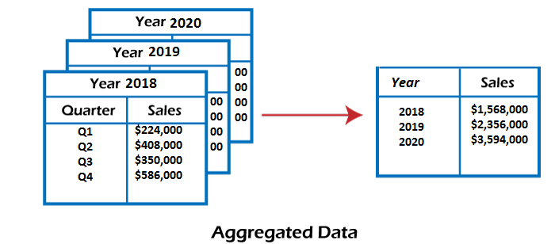
3. Data Aggregation
Data collection or aggregation is the method of storing and presenting data in a summary format. The data may be obtained from multiple data sources to integrate these data sources into a data analysis description. This is a crucial step since the accuracy of data analysis insights is highly dependent on the quantity and quality of the data used
For example, we have a data set of sales reports of an enterprise that has quarterly sales of each year. We can aggregate the data to get the enterprise's annual sales report.

Slide 35
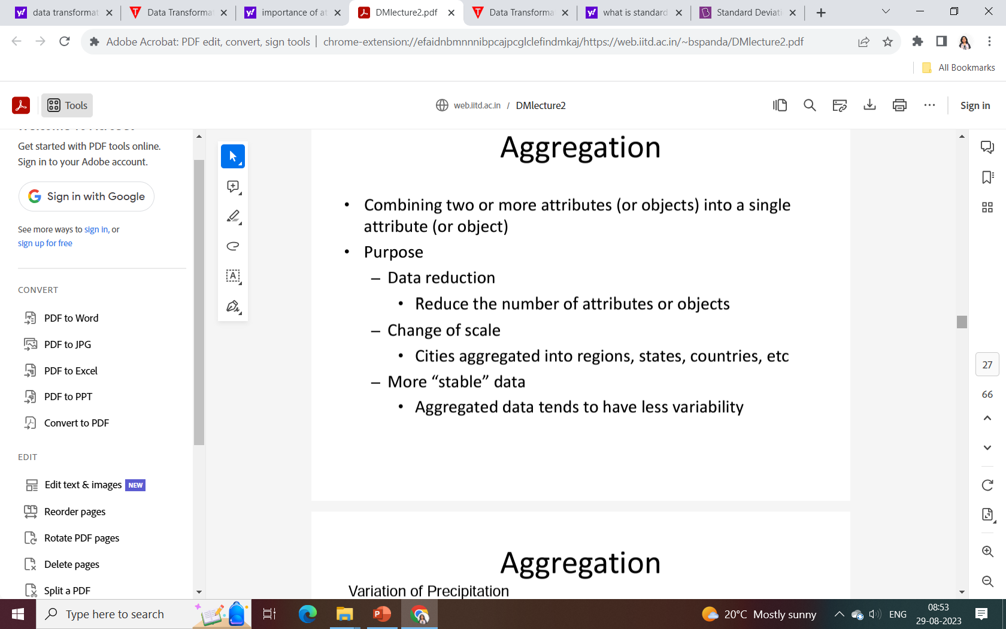

Slide 36
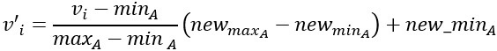
4. Data Normalization
Normalizing the data refers to scaling the data values to a much smaller range such as [-1, 1] or [0.0, 1.0]. There are different methods to normalize the data, as discussed below.
Consider that we have a numeric attribute A and we have n number of observed values for attribute A that are V1, V2, V3, ….Vn.
Min-max normalization: This method implements a linear transformation on the original data. Let us consider that we have minA and maxA as the minimum and maximum value observed for attribute A and Viis the value for attribute A that has to be normalized. The min-max normalization would map Vi to the V'i in a new smaller range [new_minA, new_maxA]. The formula for min-max normalization is given below:

Slide 37
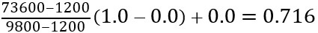
For example, we have $1200 and $9800 as the minimum, and maximum value for the attribute income, and [0.0, 1.0] is the range in which we have to map a value of $73,600.
The value $73,600 would be transformed using min-max normalization as follows:

Slide 38
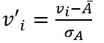
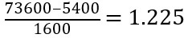
Z-score normalization: This method normalizes the value for attribute A using the meanand standard deviation. The following formula is used for Z-score normalization:
Here Ᾱ and σA are the mean and standard deviation for attribute A, respectively.
For example, we have a mean and standard deviation for attribute A as $54,000 and $16,000. And we have to normalize the value $73,600 using z-score normalization.

Slide 39
5. Data Discretization
This is a process of converting continuous data into a set of data intervals. Continuous attribute values are substituted by small interval labels. This makes the data easier to study and analyze. If a data mining task handles a continuous attribute, then its discrete values can be replaced by constant quality attributes. This improves the efficiency of the task.
This method is also called a data reduction mechanism as it transforms a large dataset into a set of categorical data. Discretization also uses decision tree-based algorithms to produce short, compact, and accurate results when using discrete values.
For example, the values for the age attribute can be replaced by the interval labels such as (0-10, 11-20…) or (kid, youth, adult, senior).

Slide 40
6. Data Generalization
It converts low-level data attributes to high-level data attributes using concept hierarchy. This conversion from a lower level to a higher conceptual level is useful to get a clearer picture of the data. Data generalization can be divided into two approaches:
Data cube process (OLAP) approach.
Attribute-oriented induction (AOI) approach.
For example, age data can be in the form of (20, 30) in a dataset. It is transformed into a higher conceptual level into a categorical value (young, old).

Slide 41
Data Reduction

Slide 42
3. Data Reduction:
Data reduction is a crucial step in the data mining process that involves reducing the size of the dataset while preserving the important information. This is done to improve the efficiency of data analysis and to avoid overfitting of the model. This process is necessary for real-world applications as the data size is big. In this process, the reduction of random variables or attributes is done so that the dimensionality of the data set can be reduced. Combining and merging the attributes of the data without losing its original characteristics. This also helps in the reduction of storage space, and computation time is reduced. When the data is highly dimensional, a problem called the “Curse of Dimensionality” occurs.

Slide 43
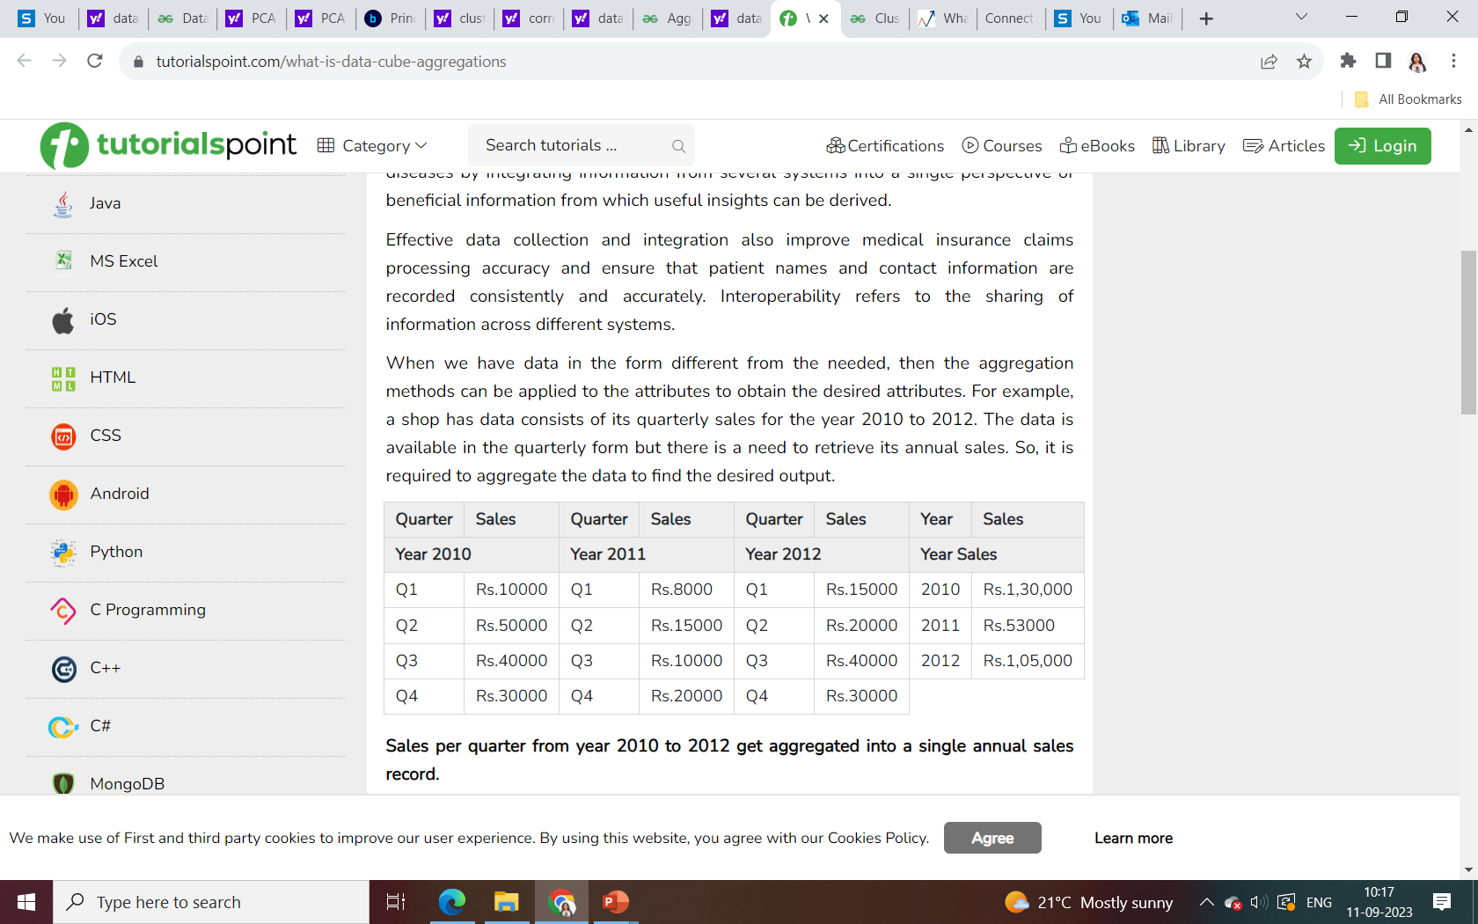
Data Cube Aggregations
When we have data in the form different from the needed, then the aggregation methods can be applied to the attributes to obtain the desired attributes. For example, a shop has data consists of its quarterly sales for the year 2010 to 2012. The data is available in the quarterly form but there is a need to retrieve its annual sales. So, it is required to aggregate the data to find the desired output.

Slide 44
Examples of aggregate data:
Finding the average age of customer buying a particular product which can help in finding out the targeted age group for that particular product. Instead of dealing with an individual customer, the average age of the customer is calculated.
Finding the number of consumers by country. This can increase sales in the country with more buyers and help the company to enhance its marketing in a country with low buyers. Here also, instead of an individual buyer, a group of buyers in a country are considered.
By collecting the data from online buyers, the company can analyze the consumer behavior pattern, the success of the product which helps the marketing and finance department to find new marketing strategies and planning the budget.
Finding the value of voter turnout in a state or country. It is done by counting the total votes of a candidate in a particular region instead of counting the individual voter records.

Slide 45
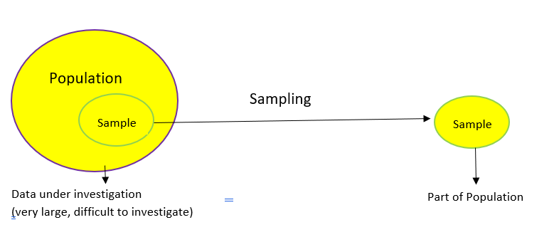
Sampling is a method that allows us to get information about the population based on the statistics from a subset of the population (sample), without having to investigate every individual.

Slide 46
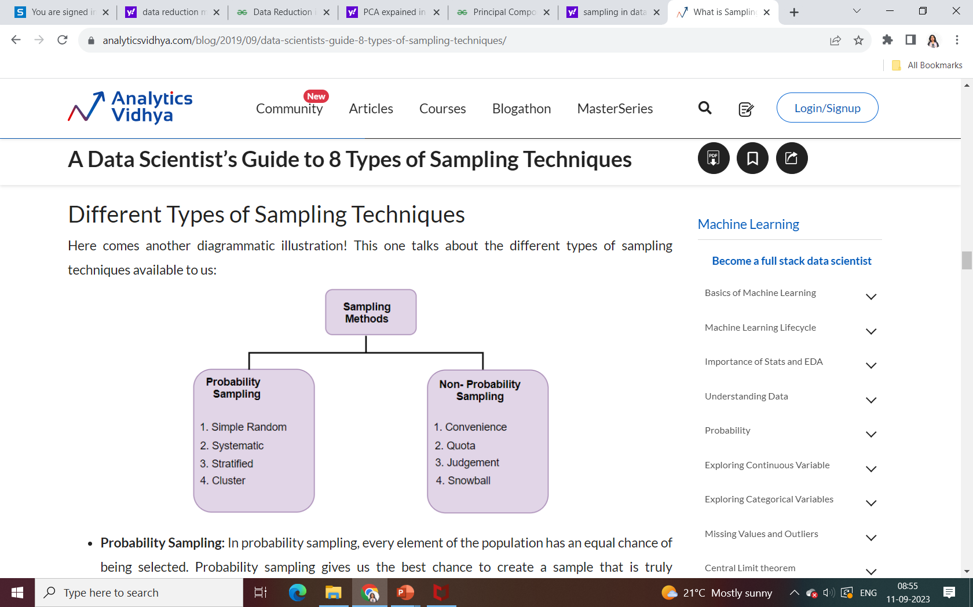
Different Types of Sampling Techniques:

Slide 47
Probability Sampling: In probability sampling, every element of the population has an equal chance of being selected. Probability sampling gives us the best chance to create a sample that is truly representative of the population
Non-Probability Sampling: In non-probability sampling, all elements do not have an equal chance of being selected. Consequently, there is a significant risk of ending up with a non-representative sample which does not produce generalizable results
For example, let’s say our population consists of 20 individuals. Each individual is numbered from 1 to 20 and is represented by a specific color (red, blue, green, or yellow). Each person would have odds of 1 out of 20 of being chosen in probability sampling.
With non-probability sampling, these odds are not equal. A person might have a better chance of being chosen than others.

Slide 48
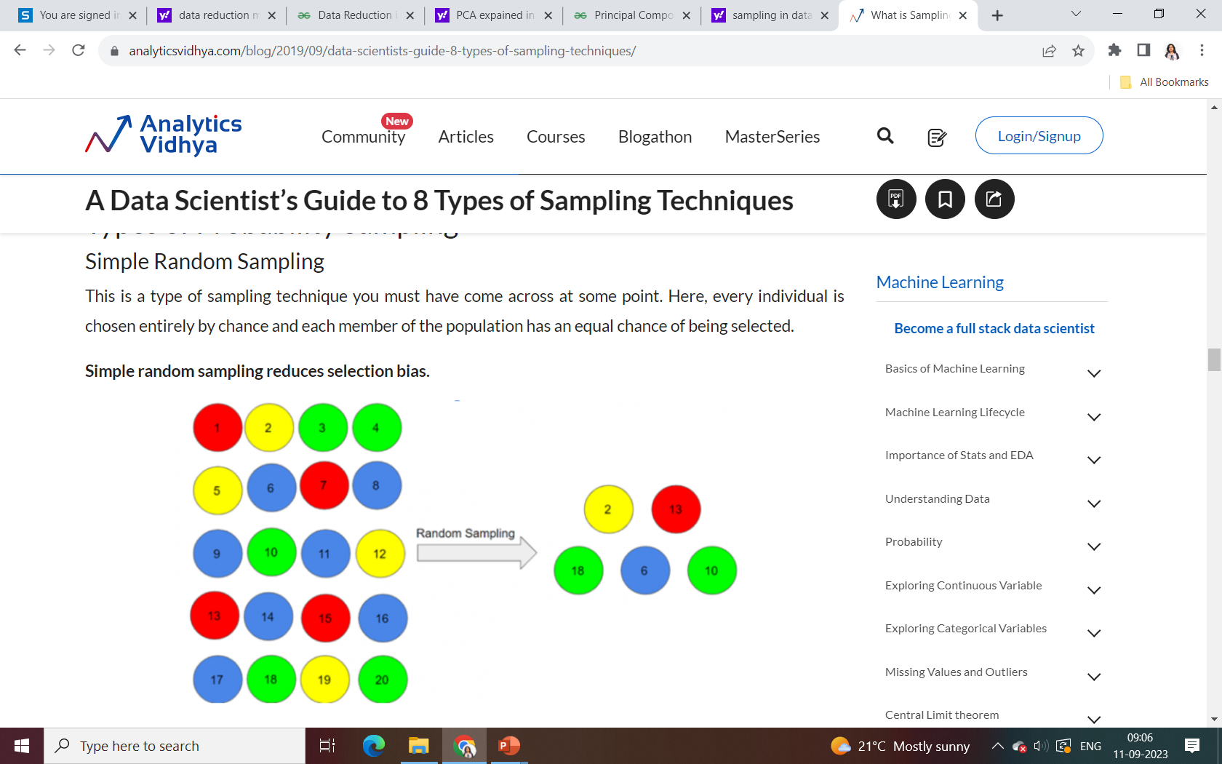
One big advantage of this technique is that it is the most direct method of probability sampling. But it comes with a caveat – it may not select enough individuals with our characteristics of interest.

Slide 49
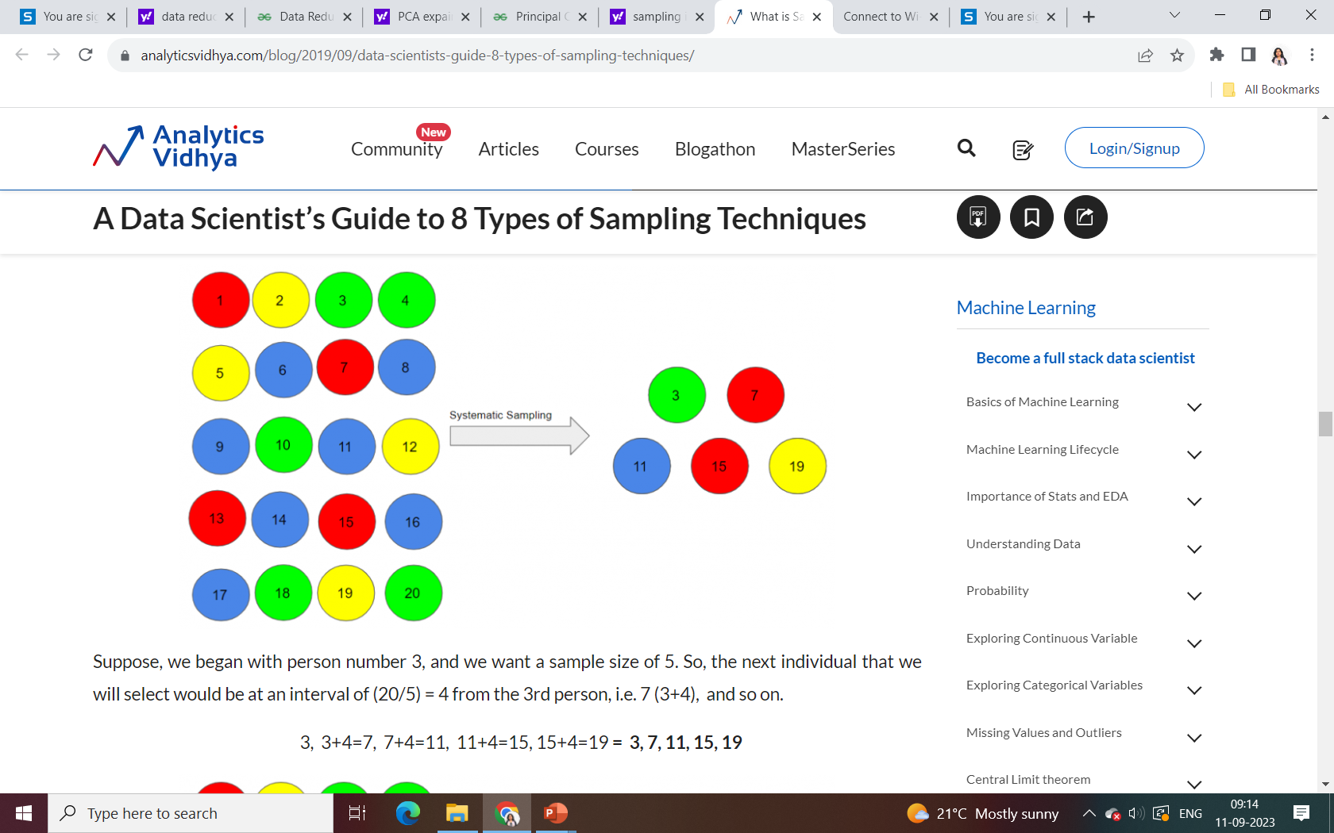
Systematic Sampling
In this type of sampling, the first individual is selected randomly and others are selected using a fixed ‘sampling interval’. Let’s take a simple example to understand this.
Say our population size is x and we have to select a sample size of n. Then, the next individual that we will select would be x/nth intervals away from the first individual. We can select the rest in the same way.

Slide 50
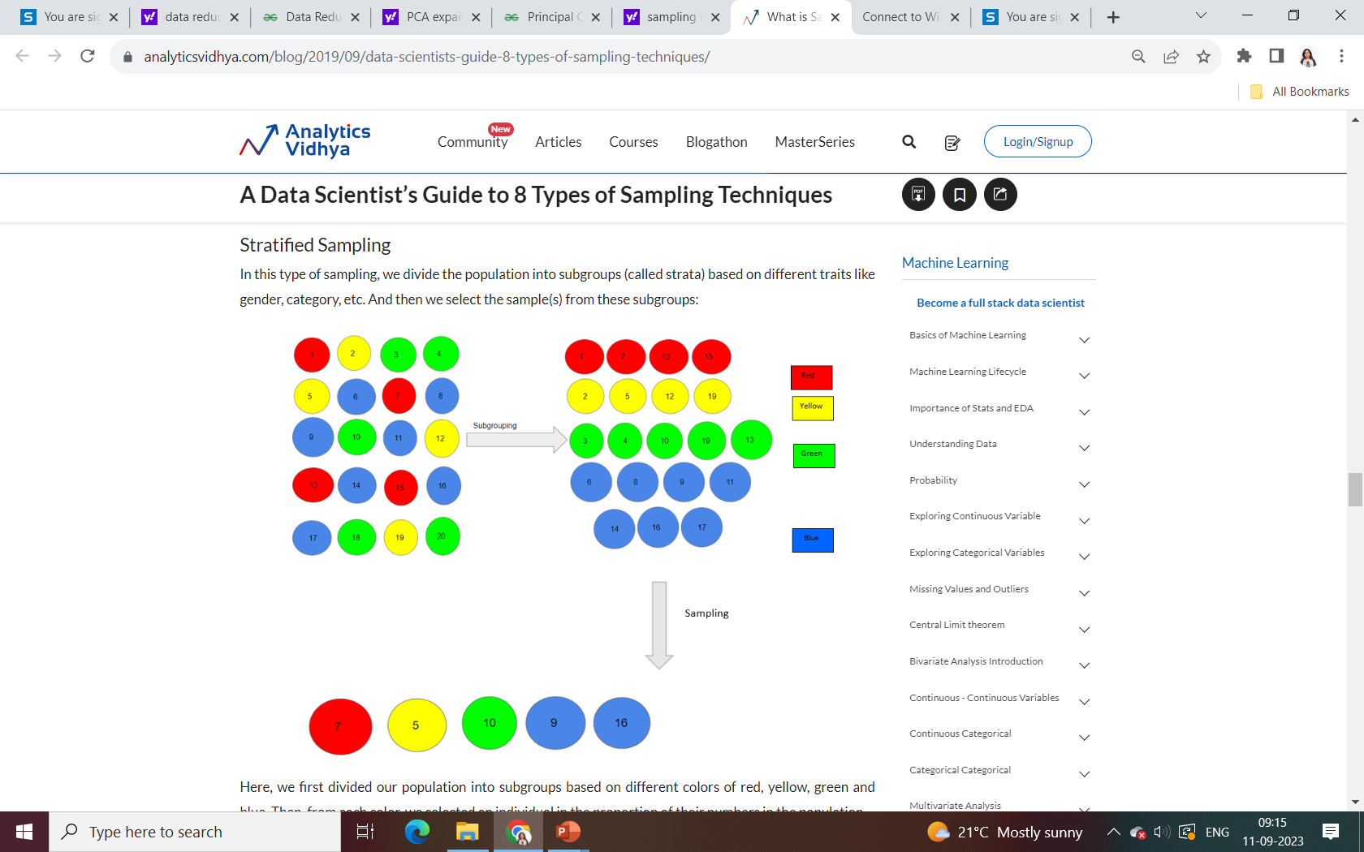

Slide 51
Here, we first divided our population into subgroups based on different colors of red, yellow, green and blue. Then, from each color, we selected an individual in the proportion of their numbers in the population.
We use this type of sampling when we want representation from all the subgroups of the population. However, stratified sampling requires proper knowledge of the characteristics of the population.

Slide 52
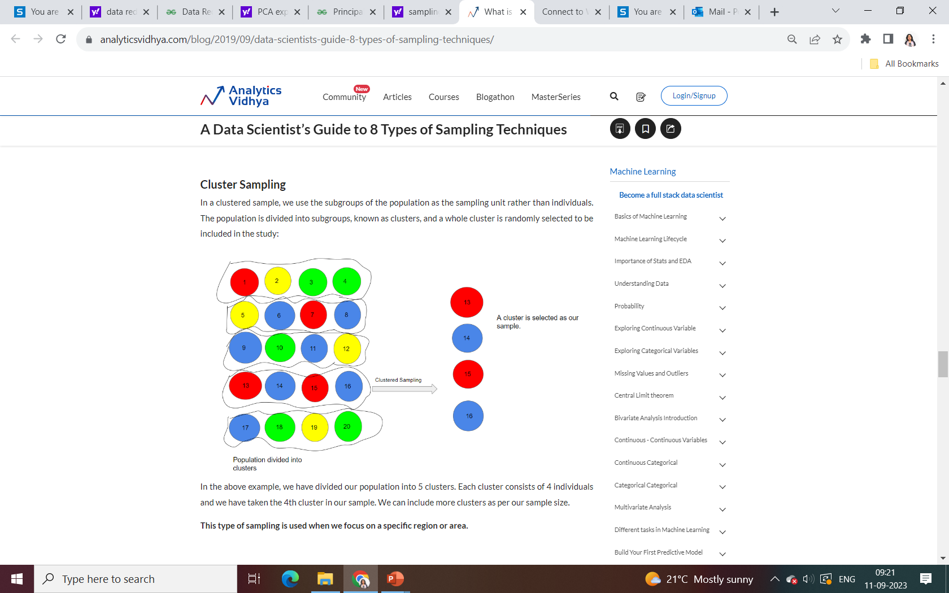

Slide 53
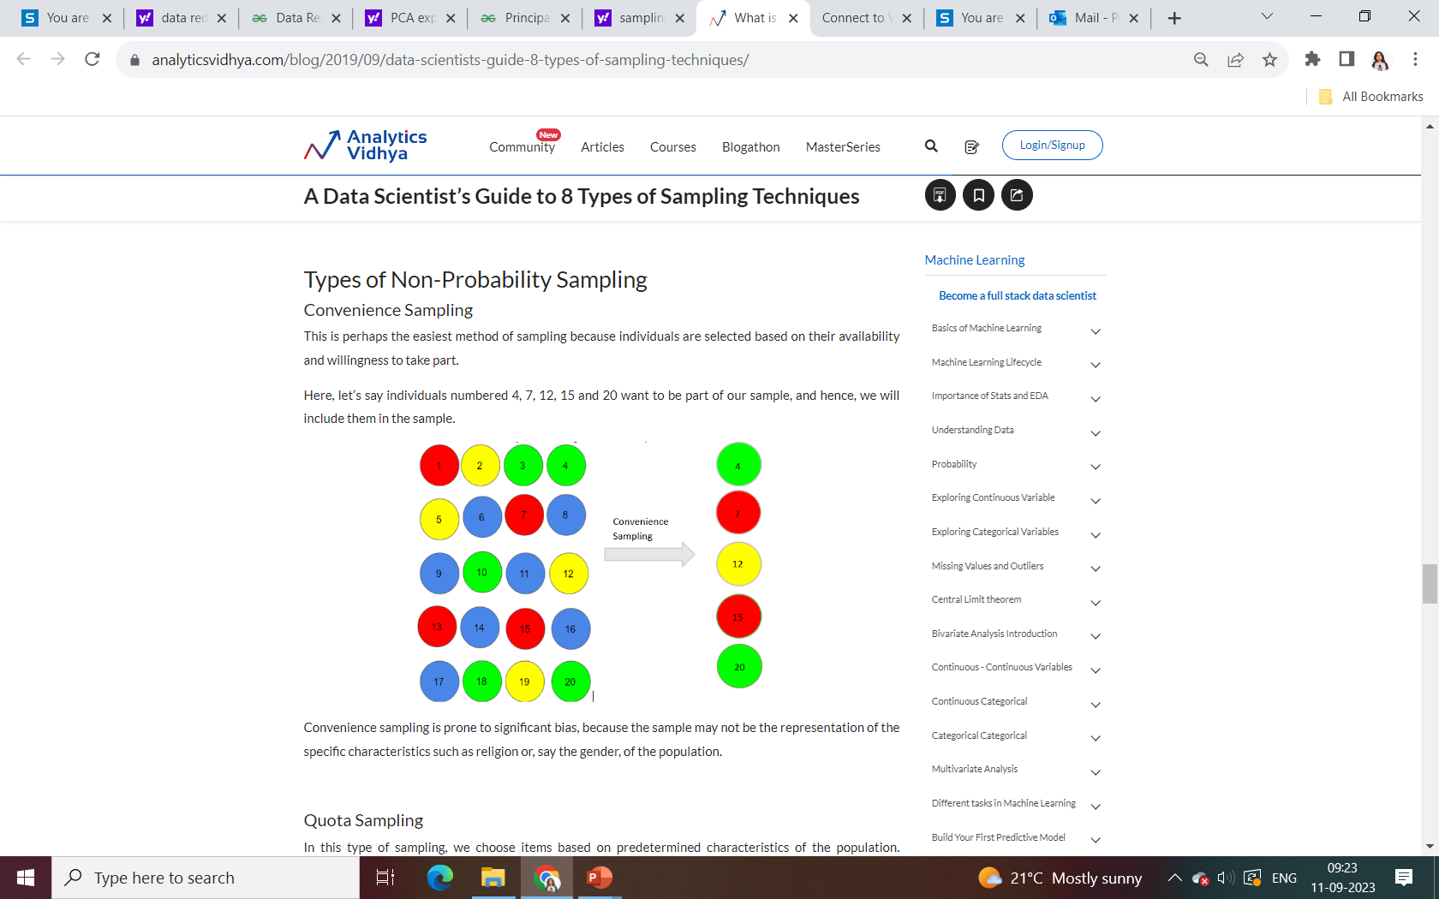

Slide 54
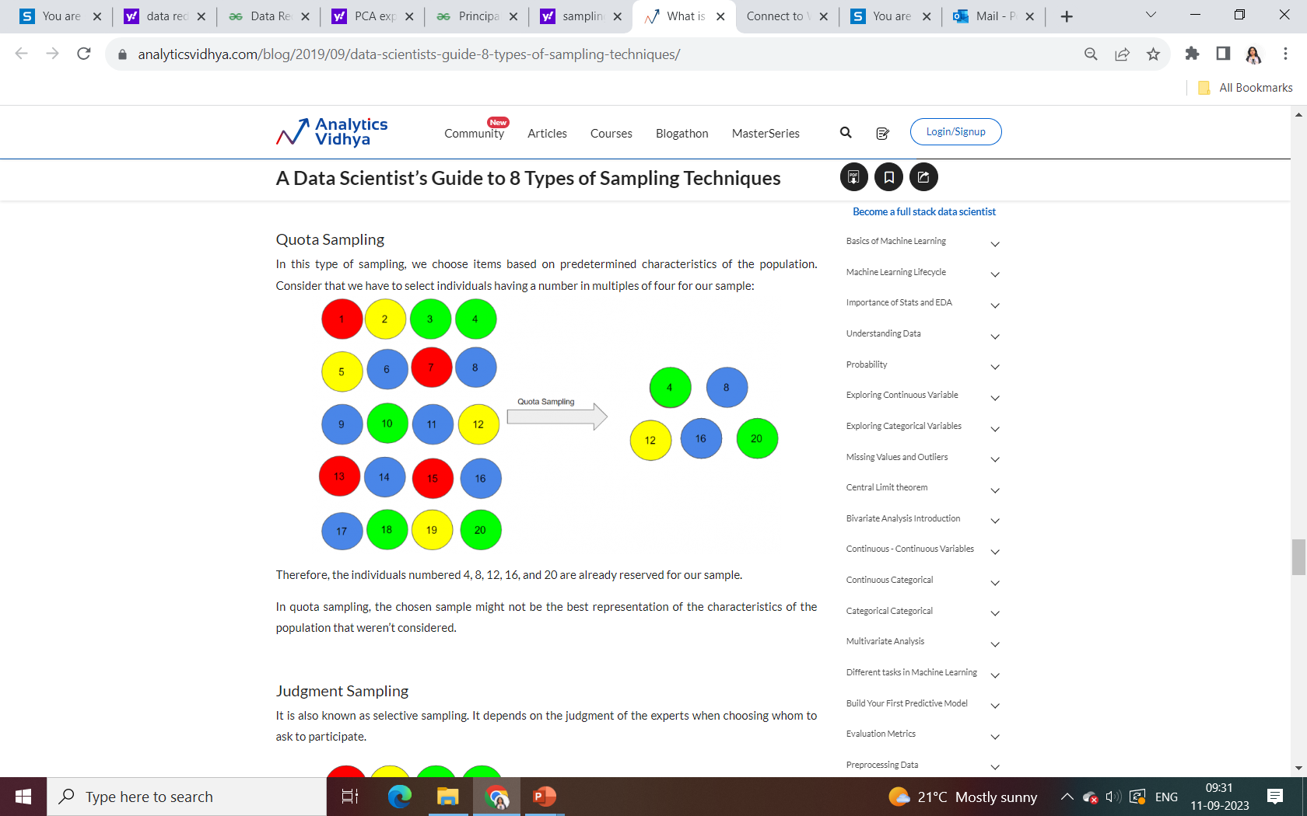

Slide 55
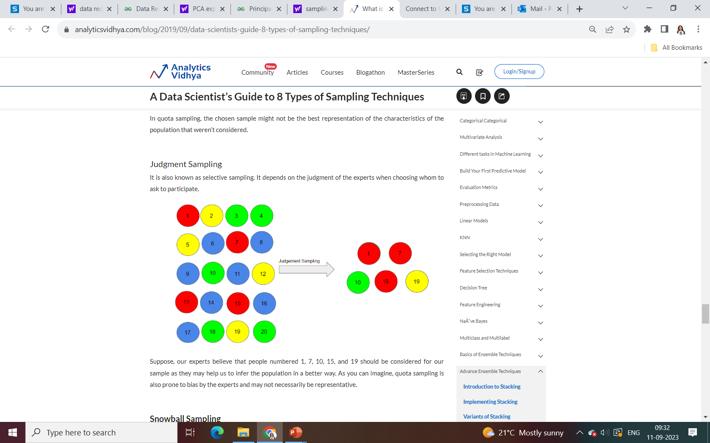

Slide 56
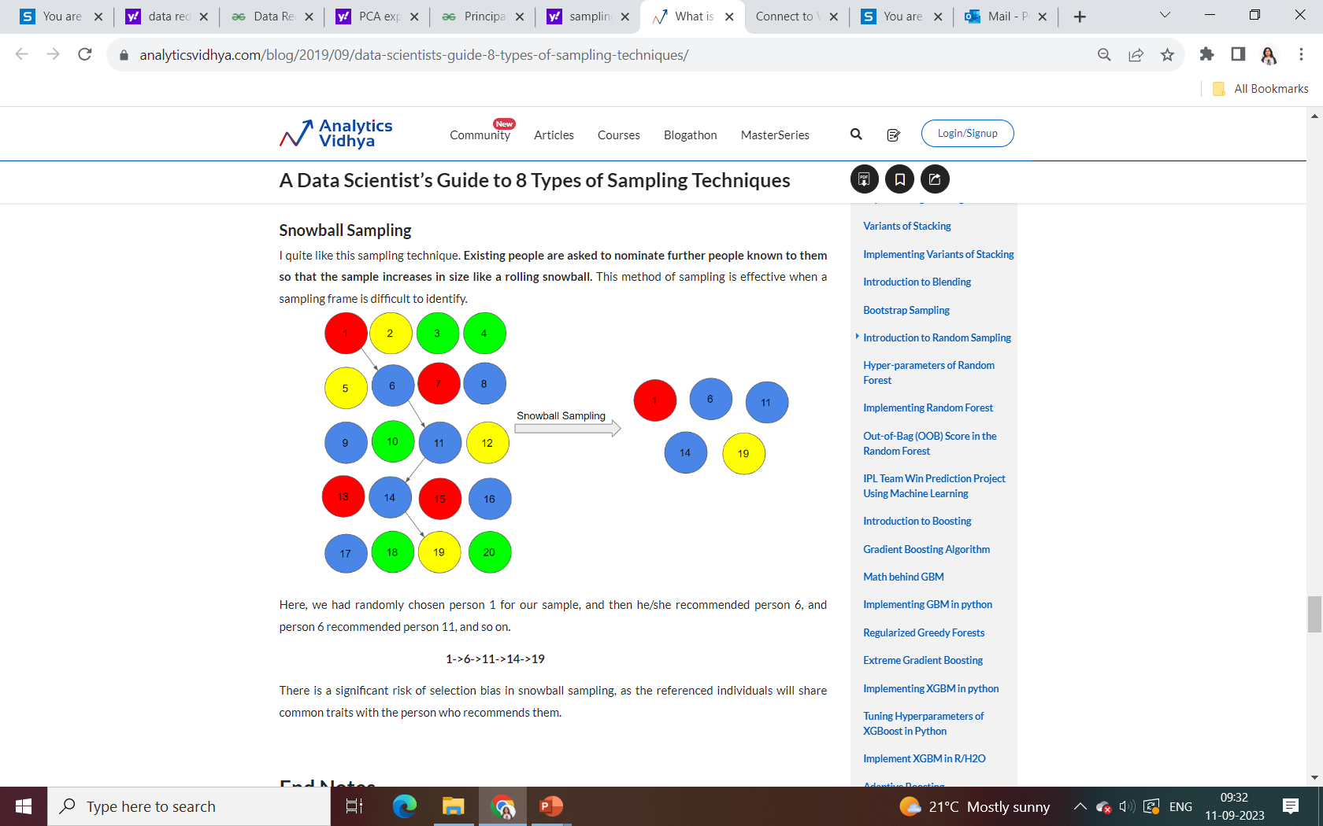

Slide 57
Data Reduction : Dimensionality Reduction
Curse of dimensionality
When dimensionality increases, data becomes increasingly sparse or skewed
Density and distance between points, which is critical to clustering, outlier analysis, becomes less meaningful
The possible combinations of subspaces will grow exponentially
Dimensionality reduction
Avoid the curse of dimensionality
Help eliminate irrelevant features and reduce noise
Reduce time and space required in data mining
Allow easier visualization
Notes:
57

Slide 58
Curse of Dimensionality
Curse of Dimensionality refers to a set of problems that arise when working with high-dimensional data. The dimension of a dataset corresponds to the number of attributes/features that exist in a dataset. A dataset with a large number of attributes, generally of the order of a hundred or more, is referred to as high dimensional data. Some of the difficulties that come with high dimensional data manifest during analyzing or visualizing the data to identify patterns, and some manifest while training machine learning models. The difficulties related to training machine learning models due to high dimensional data is referred to as ‘Curse of Dimensionality’.

Slide 59
Principal Component Analysis: Suppose we have a data set to be analyzed that has tuples with n attributes. The principal component analysis identifies k independent tuples with n attributes that can represent the data set. In this way, the original data can be cast on a much smaller space, and dimensionality reduction can be achieved. Principal component analysis can be applied to sparse and skewed data.
ii. Attribute Subset Selection: The large data set has many attributes, some of which are irrelevant to data mining or some are redundant. The core attribute subset selection reduces the data volume and dimensionality. The attribute subset selection reduces the volume of data by eliminating redundant and irrelevant attributes. The attribute subset selection ensures that we get a good subset of original attributes even after eliminating the unwanted attributes. The resulting probability of data distribution is as close as possible to the original data distribution using all the attributes.

Slide 60
Step-wise Forward Selection –
The selection begins with an empty set of attributes later on we decide the best of the original attributes on the set based on their relevance to other attributes. We know it as a p-value in statistics.
Suppose there are the following attributes in the data set in which few attributes are redundant.
Initial attribute Set: {X1, X2, X3, X4, X5, X6}
Initial reduced attribute set: { }
Step-1: {X1}
Step-2: {X1, X2}
Step-3: {X1, X2, X5}
Final reduced attribute set: {X1, X2, X5}

Slide 61
Step-wise Backward Selection –
This selection starts with a set of complete attributes in the original data and at each point, it eliminates the worst remaining attribute in the set.
Suppose there are the following attributes in the data set in which few attributes are redundant.
Initial attribute Set: {X1, X2, X3, X4, X5, X6}
Initial reduced attribute set: {X1, X2, X3, X4, X5, X6 }
Step-1: {X1, X2, X3, X4, X5}
Step-2: {X1, X2, X3, X5}
Step-3: {X1, X2, X5}
Final reduced attribute set: {X1, X2, X5}

Slide 62
Numerosity Reduction
The numerosity reduction reduces the original data volume and represents it in a much smaller form. This technique includes two types parametric and non-parametric numerosity reduction.
Parametric:
Non-Parametric:

Slide 63
Parametric
Parametric numerosity reduction incorporates storing only data parameters instead of the original data. One method of parametric numerosity reduction is the regression and log-linear method.
Regression and Log-Linear: Linear regression models a relationship between the two attributes by modeling a linear equation to the data set. Suppose we need to model a linear function between two attributes.
y = wx +b
Here, y is the response attribute, and x is the predictor attribute. If we discuss in terms of data mining, attribute x and attribute y are the numeric database attributes, whereas w and b are regression coefficients.
Multiple linear regressions let the response variable y model linear function between two or more predictor variables.
Log-linear model discovers the relation between two or more discrete attributes in the database. Suppose we have a set of tuples presented in n-dimensional space. Then the log-linear model is used to study the probability of each tuple in a multidimensional space. Regression and log-linear methods can be used for sparse data and skewed data.

Slide 64
Non-Parametric:
A non-parametric numerosity reduction technique does not assume any model. The non-Parametric technique results in a more uniform reduction, irrespective of data size, but it may not achieve a high volume of data reduction like the parametric. There are at least four types of Non-Parametric data reduction techniques, Histogram, Clustering, Sampling, Data Cube Aggregation, and Data Compression.

Slide 65
Histogram: A histogram is a graph that represents frequency distribution which describes how often a value appears in the data. Histogram uses the binning method to represent an attribute's data distribution. It uses a disjoint subset which we call bin or buckets. A histogram can represent a dense, sparse, uniform, or skewed data. Instead of only one attribute, the histogram can be implemented for multiple attributes. It can effectively represent up to five attributes.
Clustering: Clustering techniques groups similar objects from the data so that the objects in a cluster are similar to each other, but they are dissimilar to objects in another cluster. How much similar are the objects inside a cluster can be calculated using a distance function. More is the similarity between the objects in a cluster closer they appear in the cluster. The quality of the cluster depends on the diameter of the cluster, i.e., the max distance between any two objects in the cluster. The cluster representation replaces the original data. This technique is more effective if the present data can be classified into a distinct clustered.

Slide 66
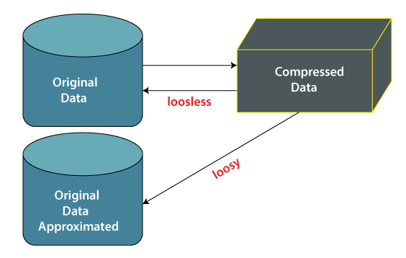
Data Compression
Data compression employs modification, encoding, or converting the structure of data in a way that consumes less space. Data compression involves building a compact representation of information by removing redundancy and representing data in binary form. Data that can be restored successfully from its compressed form is called Lossless compression. In contrast, the opposite where it is not possible to restore the original form from the compressed form is Lossy compression. Dimensionality and numerosity reduction method are also used for data compression.

Slide 67
Lossless Compression: Encoding techniques (Run Length Encoding) allow a simple and minimal data size reduction. Lossless data compression uses algorithms to restore the precise original data from the compressed data.
Lossy Compression: In lossy-data compression, the decompressed data may differ from the original data but are useful enough to retrieve information from them. For example, the JPEG image format is a lossy compression, but we can find the meaning equivalent to the original image. Methods such as the Discrete Wavelet transform technique PCA (principal component analysis) are examples of this compression

Slide 68
Concept Hierarchies:
It reduces the data size by collecting and then replacing the low-level concepts (such as 43 for age) with high-level concepts (categorical variables such as middle age or Senior).
For numeric data following techniques can be followed:
Binning –
Binning is the process of changing numerical variables into categorical counterparts. The number of categorical counterparts depends on the number of bins specified by the user.
Histogram analysis –
Like the process of binning, the histogram is used to partition the value for the attribute X, into disjoint ranges called brackets. There are several partitioning rules:
Equal Frequency partitioning: Partitioning the values based on their number of occurrences in the data set.
Equal Width Partitioning: Partitioning the values in a fixed gap based on the number of bins i.e. a set of values ranging from 0-20.
Clustering: Grouping similar data together.

